Slide 1
STOR 455 Class 32
Homework #7: Due today at 5:00pm
Exam #2 Friday in Class

Slide 2
Course Topics
Simple Linear Regression
Building a Model & Assessing Conditions
Transformations
Outliers & Influential Points
Inference for Regression Slope/Correlation
ANOVA for simple linear regression
Confidence and Prediction Intervals
Multiple Regression
Building a Model & Assessing Conditions
Methods for Choosing Predictors
Interaction Terms
Polynomial Models
Second Order Models
Multicollinearity & VIF
Nested F-Test
Cross Validation Correlation
Logistic Regression
Building a Model with a single predictors
Building a Model with multiple predictors
Tests of significance for a model (single or multiple predictors)
Test of significance for nested models
Methods for Choosing Predictors
Assessing linearity of the logit model
Confidence interval for Odds Ratio
Interpreting Odds Ratio
Predicting Probabilities

Slide 3
Practice Exam #2
```{r message=FALSE}
library(readr)
BirthWeight <- read_csv("https://raw.githubusercontent.com/JA-McLean/STOR455/master/data/BirthWeight.csv")
abalone_train <- read_csv("https://raw.githubusercontent.com/JA-McLean/STOR455/master/data/abalone_train.csv")
abalone_test <- read_csv("https://raw.githubusercontent.com/JA-McLean/STOR455/master/data/abalone_test.csv")
```

Slide 4
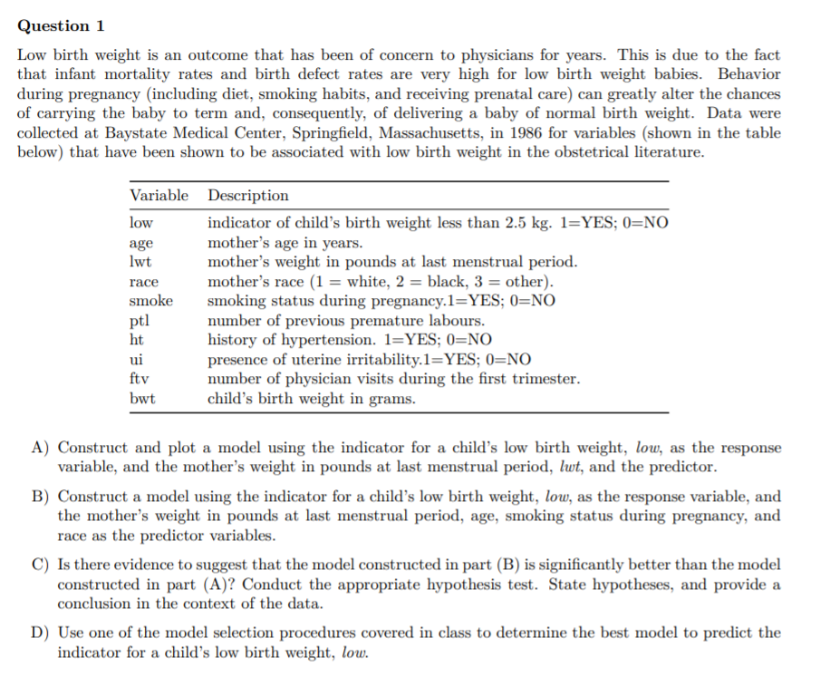

Slide 5
Course Topics
Simple Linear Regression
Building a Model & Assessing Conditions
Transformations
Outliers & Influential Points
Inference for Regression Slope/Correlation
ANOVA for simple linear regression
Confidence and Prediction Intervals
Multiple Regression
Building a Model & Assessing Conditions
Methods for Choosing Predictors
Interaction Terms
Polynomial Models
Second Order Models
Multicollinearity & VIF
Nested F-Test
Cross Validation Correlation
Logistic Regression
Building a Model with a single predictors
Building a Model with multiple predictors
Tests of significance for a model (single or multiple predictors)
Test of significance for nested models
Methods for Choosing Predictors
Assessing linearity of the logit model
Confidence interval for Odds Ratio
Interpreting Odds Ratio
Predicting Probabilities

Slide 6
Course Topics
Simple Linear Regression
Building a Model & Assessing Conditions
Transformations
Outliers & Influential Points
Inference for Regression Slope/Correlation
ANOVA for simple linear regression
Confidence and Prediction Intervals
Multiple Regression
Building a Model & Assessing Conditions
Methods for Choosing Predictors
Interaction Terms
Polynomial Models
Second Order Models
Multicollinearity & VIF
Nested F-Test
Cross Validation Correlation
Logistic Regression
Building a Model with a single predictors
Building a Model with multiple predictors
Tests of significance for a model (single or multiple predictors)
Test of significance for nested models
Methods for Choosing Predictors
Assessing linearity of the logit model
Confidence interval for Odds Ratio
Interpreting Odds Ratio
Predicting Probabilities

Slide 7
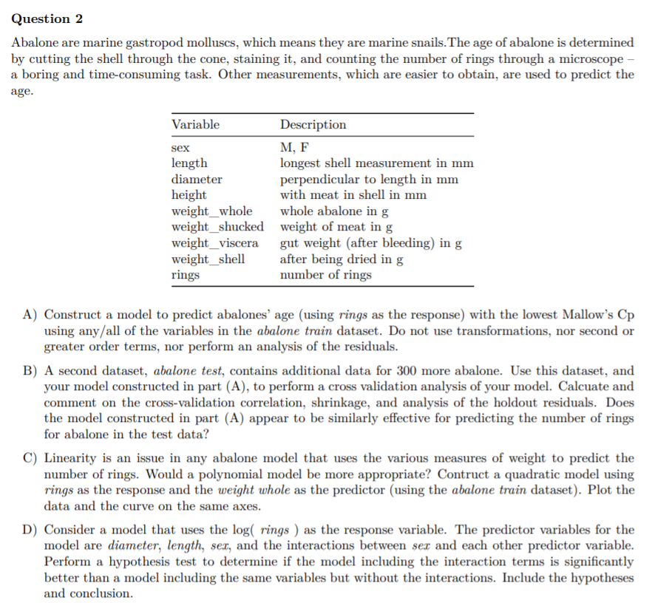

Slide 8
Course Topics
Simple Linear Regression
Building a Model & Assessing Conditions
Transformations
Outliers & Influential Points
Inference for Regression Slope/Correlation
ANOVA for simple linear regression
Confidence and Prediction Intervals
Multiple Regression
Building a Model & Assessing Conditions
Methods for Choosing Predictors
Interaction Terms
Polynomial Models
Second Order Models
Multicollinearity & VIF
Nested F-Test
Cross Validation Correlation
Logistic Regression
Building a Model with a single predictors
Building a Model with multiple predictors
Tests of significance for a model (single or multiple predictors)
Test of significance for nested models
Methods for Choosing Predictors
Assessing linearity of the logit model
Confidence interval for Odds Ratio
Interpreting Odds Ratio
Predicting Probabilities

Slide 9
Course Topics
Simple Linear Regression
Building a Model & Assessing Conditions
Transformations
Outliers & Influential Points
Inference for Regression Slope/Correlation
ANOVA for simple linear regression
Confidence and Prediction Intervals
Multiple Regression
Building a Model & Assessing Conditions
Methods for Choosing Predictors
Interaction Terms
Polynomial Models
Second Order Models
Multicollinearity & VIF
Nested F-Test
Cross Validation Correlation
Logistic Regression
Building a Model with a single predictors
Building a Model with multiple predictors
Tests of significance for a model (single or multiple predictors)
Test of significance for nested models
Methods for Choosing Predictors
Assessing linearity of the logit model
Confidence interval for Odds Ratio
Interpreting Odds Ratio
Predicting Probabilities

